Slide 1

PFuzeSangLuis
Group 1

Slide 2



Dashboard for Monitoring and Signaling Elder's Heart Disease

Slide 3
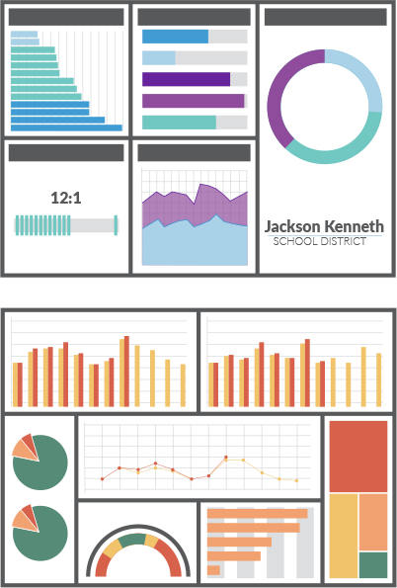
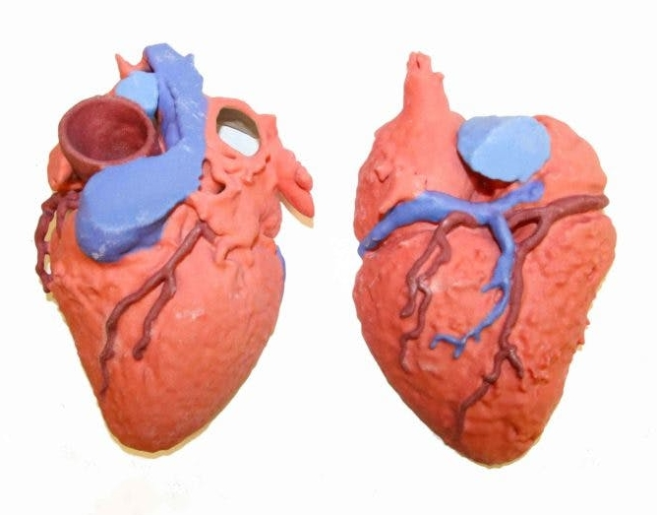
Project Description
Dashboard for Monitoring and Signaling Elder’s Heart Disease is a tool used for display important information about elder’s activities and heart disease risk.
Using data visualization, dashboard uniquely communicate metrics visually to help users understand complex relationships in elder’s activities data.
Machine learning is used to measure elder’s heart disease risk, send this information to display on the dashboard.

Slide 4
Get requirement
Who are stakeholders?
Ans > Hospital, Organizations, and Families
Who are users?
Ans > Doctors , Organizations , Elders, and Families
What is your goal?
Ans > To identify elder’s heart disease before it happen
What is the input to your system?
Ans > Behavior data, sensor data and medical inspection result
What is the output of your system?
Ans > Dashboard and Signal
What technologies do you need to achieve your goal?
Ans > Big data and Machine learning

Slide 5
Conceptual Design

Slide 6
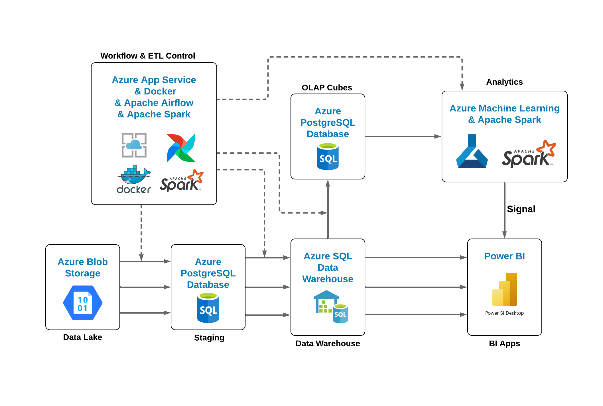
Data Pipeline Design

Slide 7
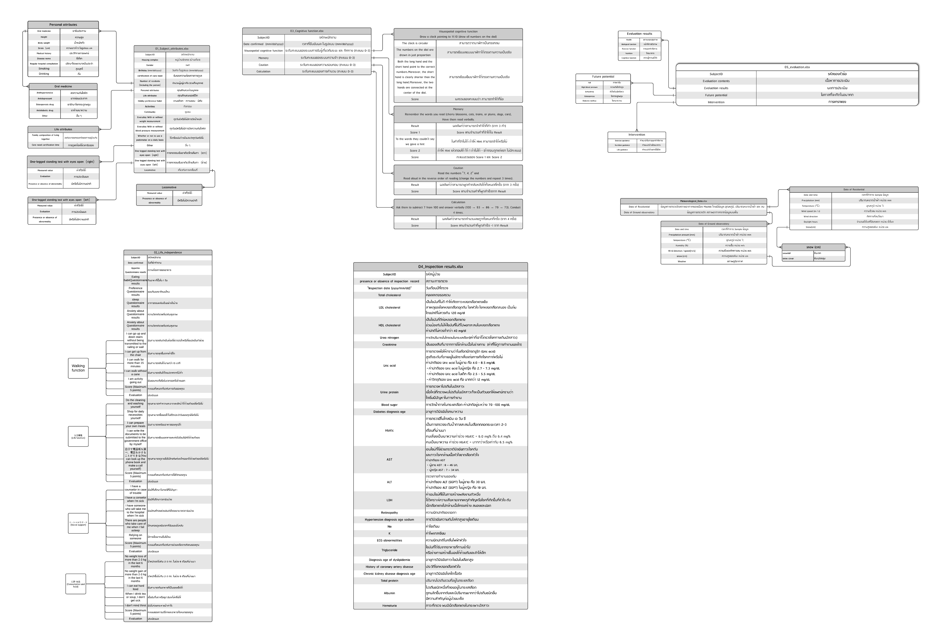
Overview Metadata of Sensei Data

Slide 8
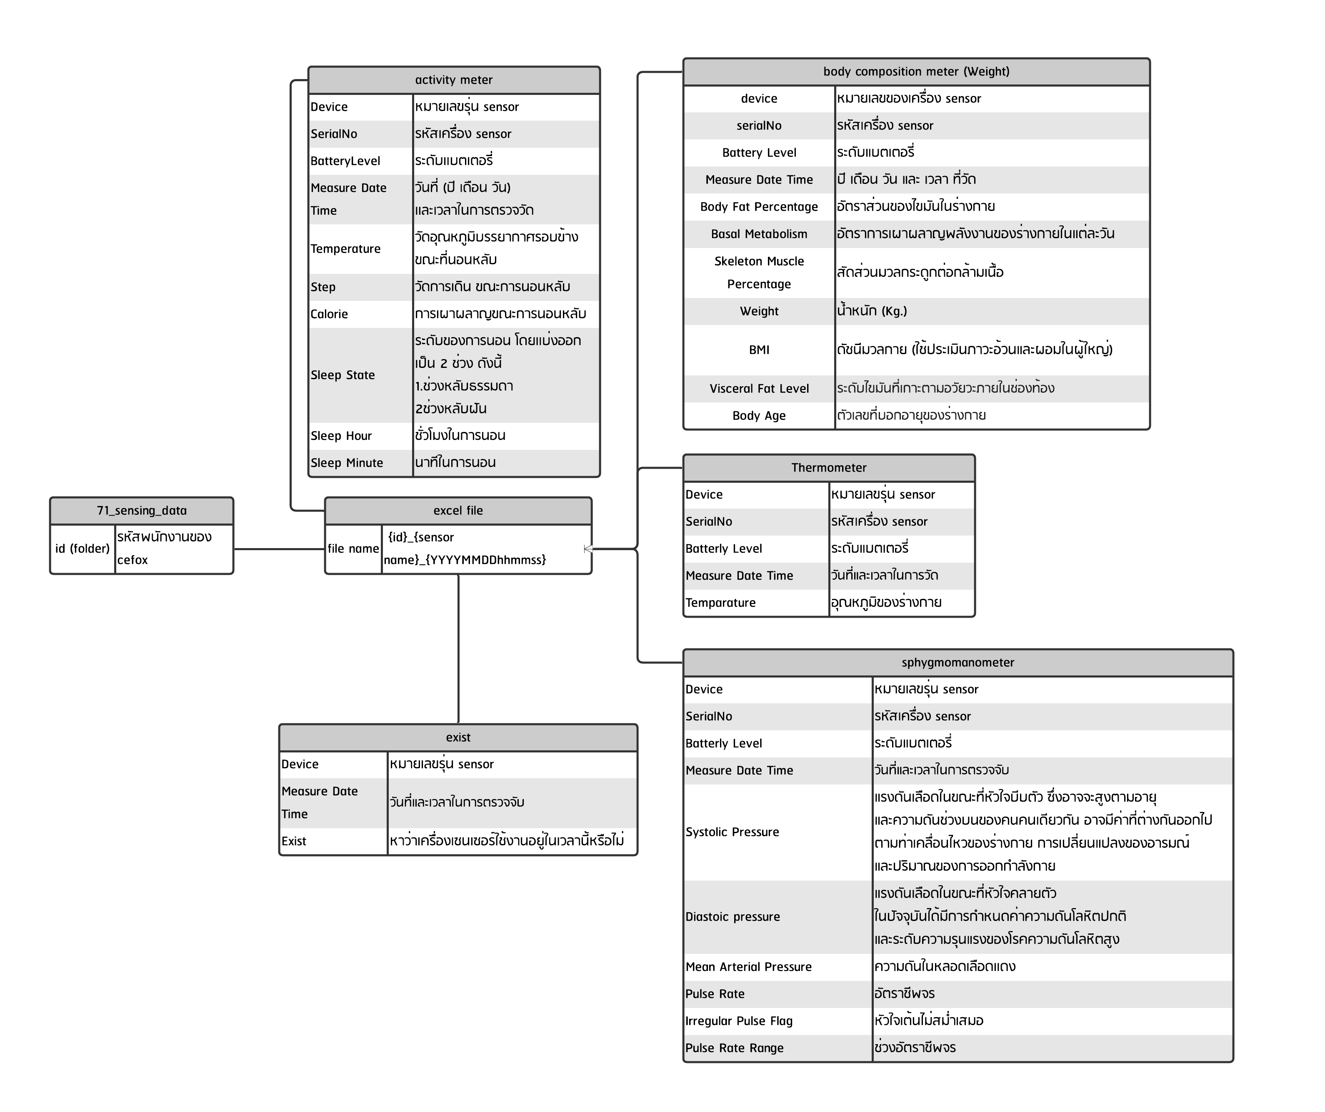
Overview Metadata of 71_sensing_data

Slide 9
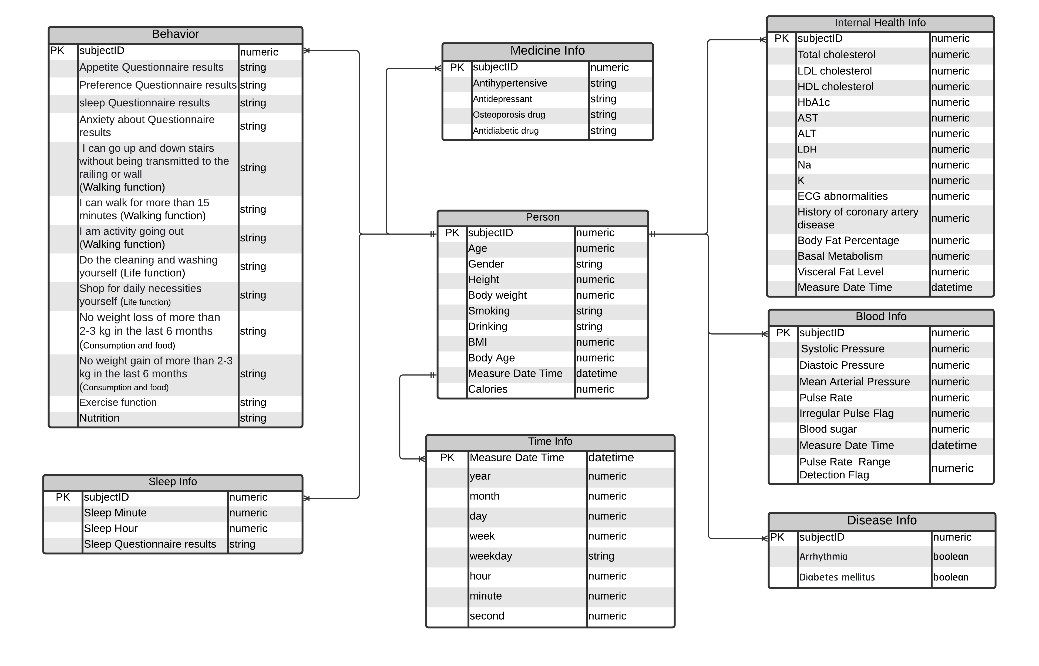
Data Model

Slide 10
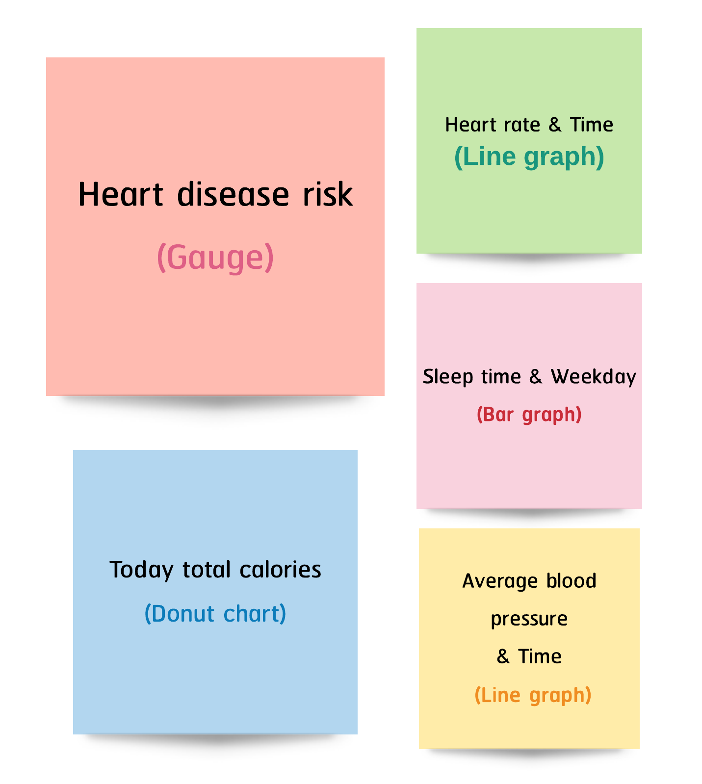
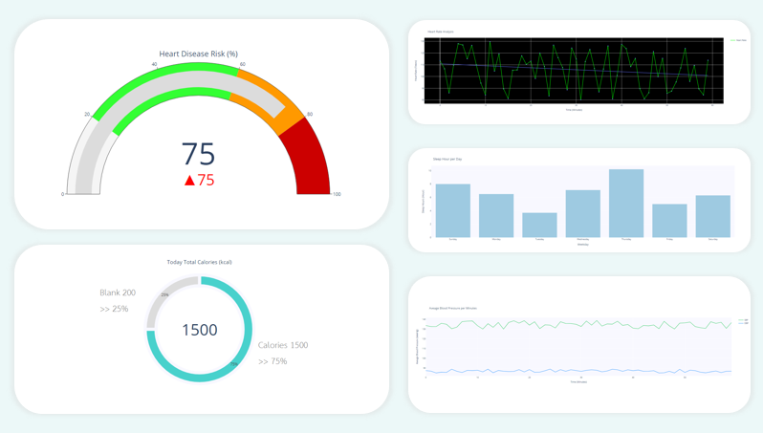
Query Design
Dashboard Design

Slide 11
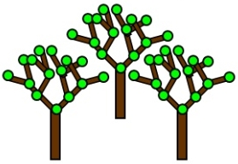
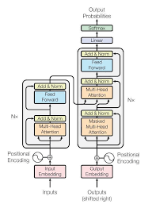
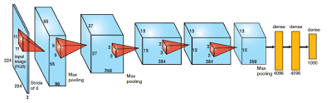
Heart Disease Prediction using Machine Learning
Random Forest
Dataset
Attention-based
Soft Voting
Probability Output
CNN

Slide 12

Members & Responsibility
Responsibility
Kao : Secretary & Testing
Bank : Leader & Programming
Eye : Data Cleansing
New : Data Cleansing
Fuze : Programming

Slide 13
References
A Survey on Prediction Techniques of Heart Disease using Machine Learning – IJERT
22.pdf (acadpubl.eu)
Information | Free Full-Text | Ensemble Deep Learning Models for Heart Disease Classification: A Case Study from Mexico (mdpi.com)
Heart Disease - Automatic AdvEDA & FE & 20 models | Kaggle

